Slide 1
REST API Fundamentals
DRW12
Rick Bauer, CCDE #2014::8, CCIE #9482
Technical Solutions Architect

Slide 2
Getting Started
REST API Fundamentals
https://developer.cisco.com/learning/modules/rest-api-fundamentals/
Presentation
https://github.com/rickbauer9482/IMPACT2022-Presentation

Slide 3
REST API Concepts

Slide 4
What the heck are REST APIs?
API (Application Programming Interface) – how two applications can communicate a contract of request responses.
REST (Representational State Transfer) – is a set of architectural constraints or criteria that can be implemented as needed.
Notes:
For an API to be considered RESTful it must:
Be Client/Server
Use HTTP
Stateless
Cacheable
Uniform defined interface between components – identifiable, self-descriptive, and can be manipulated but the client

Slide 5
HTTP Verbs
HTTP Verbs correspond to the Create, Read, Update, Delete (CRUD) actions
POST | Create
GET | Read
PUT | Update
PATCH | Update
DELETE | Delete

Slide 6
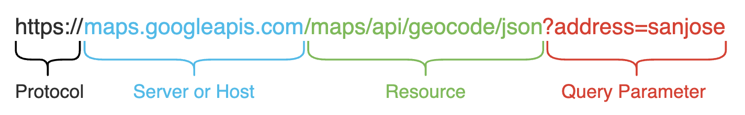
Anatomy of the REST URI
URI – is a noun that represents a resource

Slide 7
HTTP Response Codes
Status Code | Status Message | Meaning
200 | OK | All Good
201 | Created | New Resource Created
400 | Bad Request | Request was invalid
401 | Unauthorized | Auth missing or incorrect
403 | Forbidden | Request not allowed
404 | Not Found | Resource not found
500 | Internal Server Error | Something wrong on Server
503 | Service Unavailable | Server not able to complete request

Slide 8
API Headers
Header | Example Value | Purpose
Content-Type | Application/json | Format of the data in the body
Accept | Application/json | Requested format for the returned data such as json or xml
Authorization | Bearer Token Basic OAuth 1.0/2.0 | Provide credentials like a time based token, to authorize the request
Date/Time Stamp | Mon Aug, 29 16:30:23 PST 2022 | Data and time of a request or response

Slide 9
Consuming REST APIs

Slide 10
HTTP Verbs for REST APIs

Slide 11
JSON and XML Payloads

Slide 12
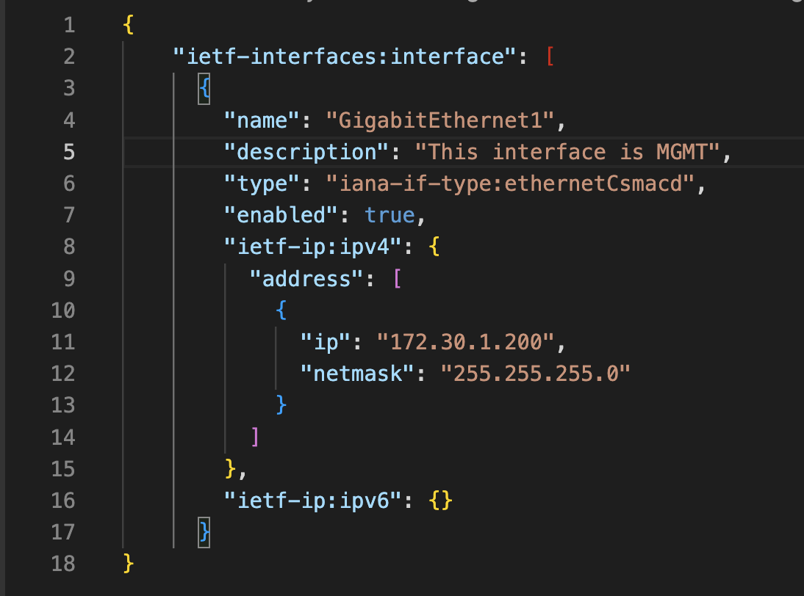
JSON
The object is an unordered set of name-value pairs.
An object begins with { (left brace) and ends with } (right brace)
Strings are wrapped with " (double quotes)

Slide 13
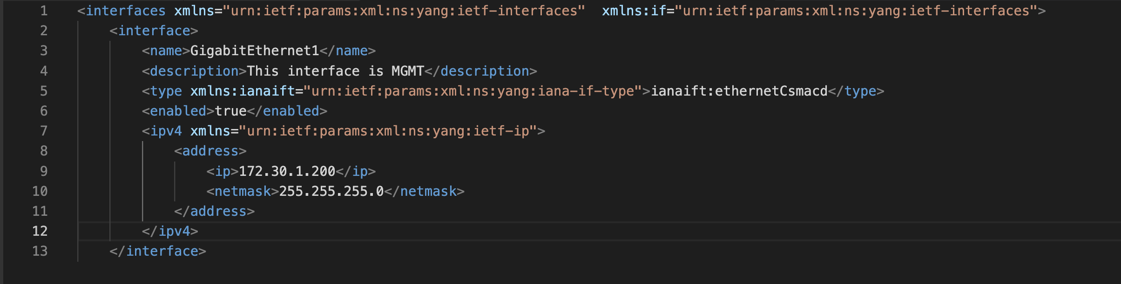
XML
XML stands for eXtensible Markup Language, and XML is designed to store and transport data.

Slide 14
Using REST APIs

